Slide 1
Introductory General Chemistry
Chemistry 3A
S. M. Halloran

Slide 2
Discovery of Radioactivity
Radioactivity Types: Alpha, Beta, Gamma
Half-Life in Radioactivity
Nuclear Chemistry: Purposeful Use of Radioactivity

Slide 3
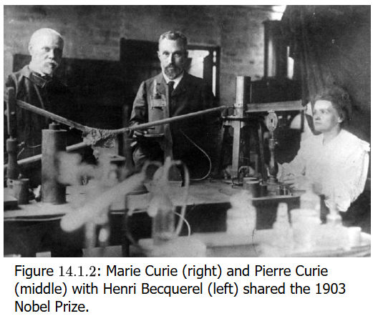
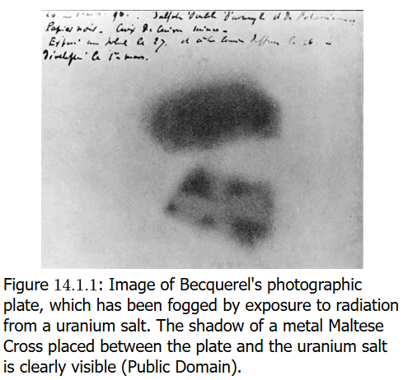
Discovery of Radioactivity
Roentgen learns that X-radiation can also expose photographic film
Becquerel learn if fluorescent minerals can have same effect (no), but sees that one rock with uranium salt minerals fogged the photographic plate
Marie & Pierre Curie determine that the element radium has even more radioactivity than uranium

Slide 4
Nuclear Binding Energy
Except for ¹H nucleus, all atoms have multiple protons in a nucleus
As like charges repel, something must keep protons held together in the nucleus. This is a force called nuclear binding energy
This binding energy keeps nuclei stable. But too little binding energy can lead to natural radioactivity (nuclear disintegration)
Scientists can force (smash) nuclei together to cause artificial radioactivity
All kinds of radioactivity (nuclear disintegration) leads to energy release

Slide 5
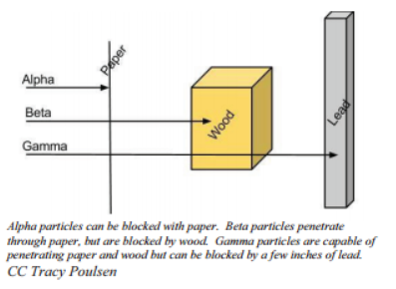
Alpha, Beta, Gamma Radioactivity
All nuclei with 84 and more protons are radioactive, and those with less have stable and unstable isotopes
The decay of radioactive isotopes can be alpha, beta, and gamma
The radiation of this nuclear disintegration can be damaging to atoms and the molecules/compounds of which they are part, and to cells and tissues in which these compounds exist
The energy of the radiation can cause ionization, usually by knocking out electrons from atoms
However, some radiation can be blocked, indicating some protection

Slide 6
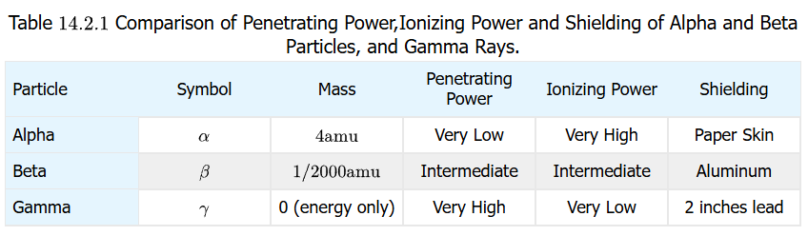
Ionization versus Penetrating Power
Generally there is a trade-off in ionizing power versus penetrating power
Alpha particles have a large mass compared to beta particles & gamma rays, so they do not penetrate very much. But they have considerable ability to ionize and damage molecules/compounds
Beta have far more penetrating power but less ionizing power
Gamma rays have no mass, are most penetrating, but less ionizing

Slide 7

Alpha Decay
Many isotopes of different elements show this type of nuclear disintegration. Examples:
${}_{92}^{238}U→{}_{2}^{4}{He}+{}_{90}^{234}{Th}$
${}_{90}^{230}{Th}→{}_{2}^{4}{He}+{}_{88}^{226}{Ra}$
Note the 2nd decay event is actually the product of the 1st decay event
Recall that this notation is ${}_{Z}^{A}{El}$ where El is the element, A = mass number, and Z = atomic number
Note that mass (A) and atomic (Z) number is conserved on both sides of the decay arrow
238 = 4 + 234, 92 = 2 + 90

Slide 8

Beta Decay
In beta radiation, an electron is thrown out of the atomic nucleus at very high speed
How does an electron come from a nucleus? It is believed a neutron decays to a proton, which stays in the nucleus, and an electron is also spun out. Mass and charge are conserved! The element is converted to a new element
${}_{90}^{234}{Th}→{}_{−1}^{0}e+{}_{91}^{234}{Pa}$ (mass & charged conserved always)
Sometimes ${}_{−1}^{0}e$ is symbolized as ${}_{−1}^{0}β$
Note that thorium-234 can decay by alpha and beta decay

Slide 9
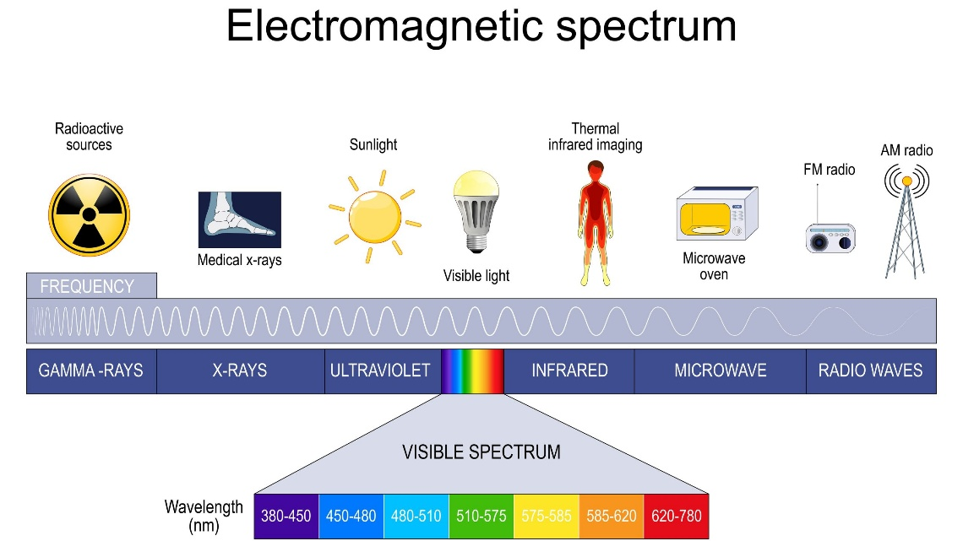

Gamma Radiation
Alpha and beta decay are particles, having mass of a helium nucleus or at least an electron
Gamma rays are photons, part of the same electromagnetic radiation spectrum as visible light, ultraviolet, x-rays, infrared, microwave, and radio waves
In the alpha decay of U-238 process, this actually was accompanied by emission of two gamma rays of different energies:
${}_{92}^{238}U→{}_{2}^{4}{He}+{}_{90}^{234}{Th}+2$ ${}_{0}^{0}γ$
In fact, all nuclear decay reactions shown for alpha and beta decay include emitted gamma radiation

Slide 10
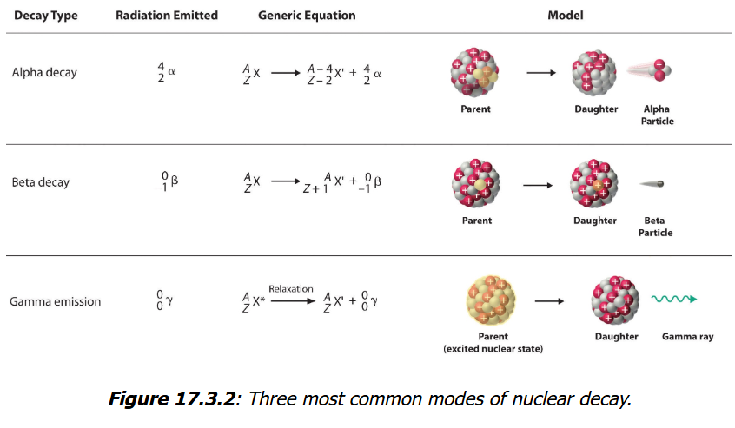
Summary
All radioactivity involves significant energies
Chemical bond energy releases are up to 10³ kJ/mol
But radioactivity is from 10⁸ to 10¹⁰ kJ/mol, about a million times more energy

Slide 11
“Nuclear Accounting”
Mass is conserved: both atomic (Z) and mass (A) numbers must equal on both sides of the decay arrow
Nuclear—not electron(ic)—charge is conserved in these equations. Generally the effect on electrons orbiting an atom involved in nuclear decay are not accounted for and the effect unknown. The nuclear charge effect is reflected in the changes of the atomic number (Z value), since Z is a direct count of the protons in a nucleus

Slide 12
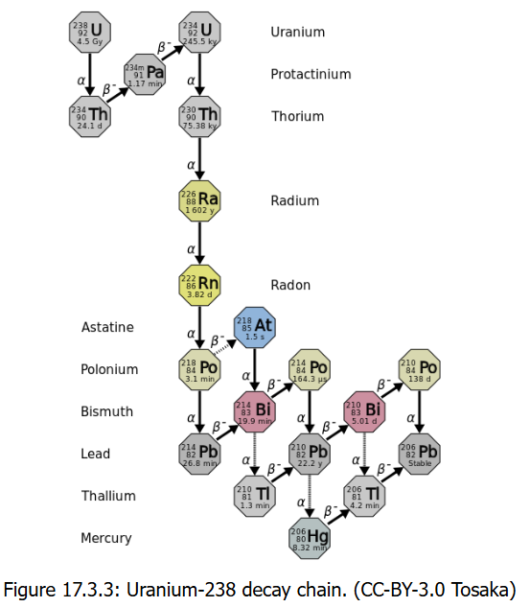
A Series of Decay
The U-238 isotope will actually undergo a series of decays as it progresses to an isotope that is stable
A total of 14 decays will occur as U-238 decays to Pb-206.
U-235 will decay to Pb-207
Th-232 will end in Pb-208
Billions/millions of years ago there may have been Radon naturally but it has all decayed.

Slide 13
Half-Life
Amount of radioactivity as it decays clearly decreases with time
Period of time for that amount of radioactivity to decrease by half (50%) is called the half-life
Half-life is symbolized by t_{1/2}.
Half-lives for many isotopes can range from nanoseconds to billions of years
Period Range | Approximate Value | Example Isotope | Use/Context
Extremely Short | Nanoseconds (10⁻⁹ s) | Polonium-212 (299 ns) | Part of the uranium decay series.
Seconds/ Minutes | Seconds (10⁻² to 10³ s) | Oxygen-15 (≈2 minutes) | Used in Positron Emission Tomography (PET) scans.
Hours/Days | hours to days (10³ to 10⁶ s) | Technetium-99m (≈6 hours) | Most widely used medical diagnostic isotope.
Years/ Centuries | years to centuries (10⁷ to 10¹⁰ s) | Cesium-137 (≈30 years) | Nuclear fallout/waste.
Geological Time | thousands to billions of years (10¹¹ to 10¹⁷ s) | Carbon-14 (≈5,730 years) | Used for carbon dating.
Primordial | billions of years (10¹⁷ s +) | Uranium-238 (≈4.5 billion years) | Used for geological dating of Earth rocks.

Slide 14
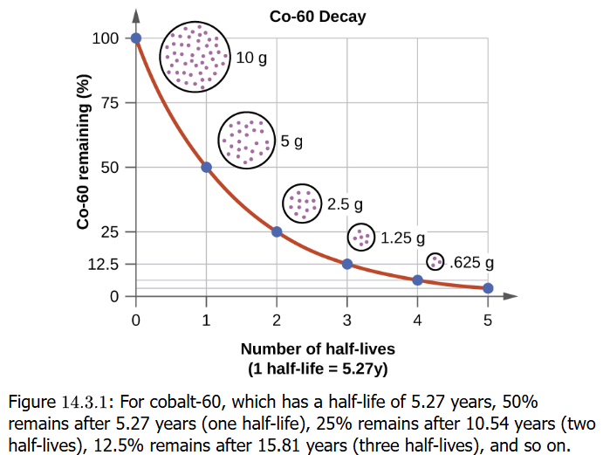
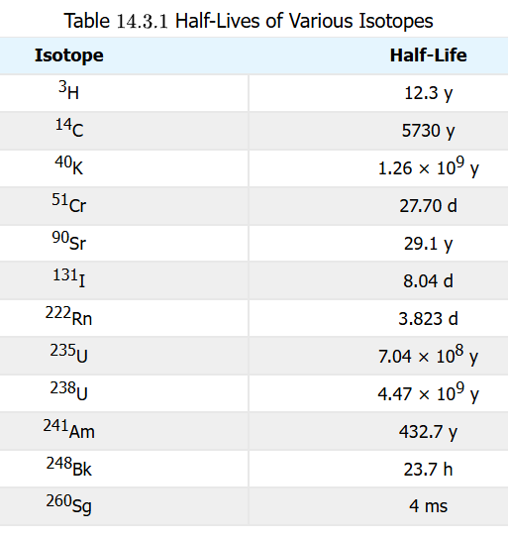

Half-Life
Cobalt-60 has a half-life of 5.27 y
If at time t = 0, there is 10 g cobalt-60, at time t = 5.27 y, there will be 5 g. At time t = 10.54 y, there will be 2.5 g
At t = 15.81 y, now 1.25 g, and at t = 21.08 y, which is 5 half-lives, the amount remaining is now 0.625 g
It follows a curve: $A=A_{0}$

Slide 15
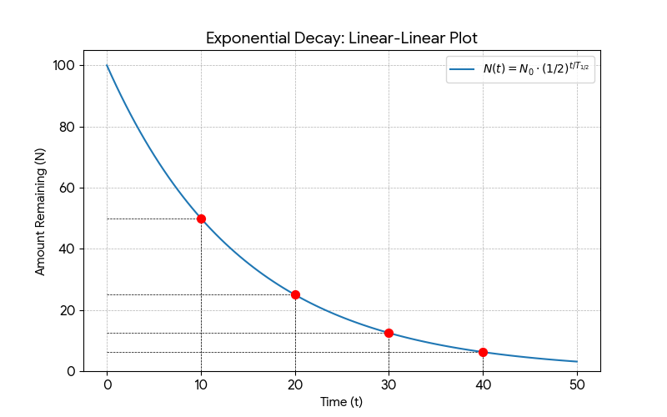
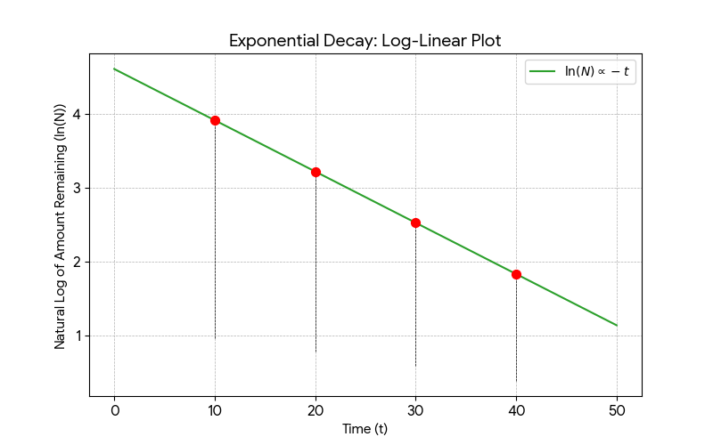

Half-Life
The math involving first-order (only one reactant) process that is radioactive decay is so important it must be understood graphically
Flourine-20 has t_{1/2} =11.0 s. If initial sample is 5.00 g of fluorine-20, how much is left after 44.0 s?
$A=5.00 g ×{\left(\frac{1}{2}\right)}^{4}=5.00 g ×$ $\left(\frac{1}{16}\right)=0.313 g$

Slide 16
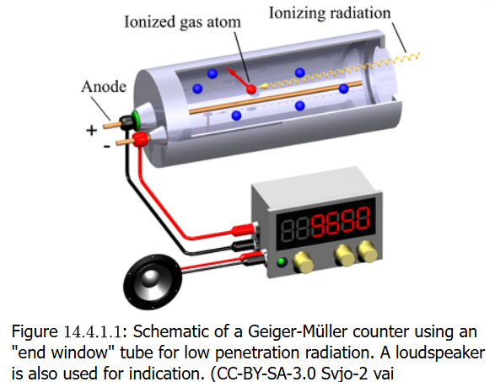
Detecting Radioactivity
Because alpha, beta, and gamma radiation is ionizing, instruments like a Geiger-Muller tube can be constructed to detect ionizations of gases in the instrument as electric currents created to register counts and to hear the count as an audible “click”
These counts occur without any identifiable source of radiation. This is called background radiation

Slide 17
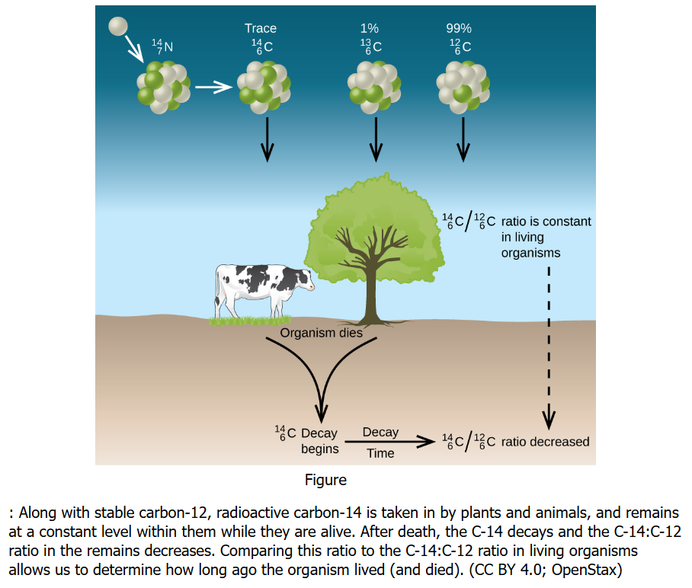
Radiometric Dating
Radioisotopes can be used date object origin
Carbon-14 in particular can be used to date things that were living organisms (radiocarbon or carbon-14 dating)
Carbon-14:carbon-12 ratio can be used to determine how long ago an organism lived. Ratio is constant while organism is alive, but decreases after death

Slide 18
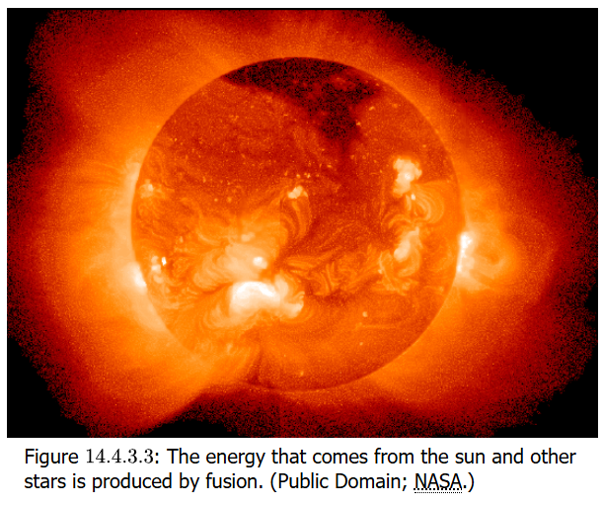
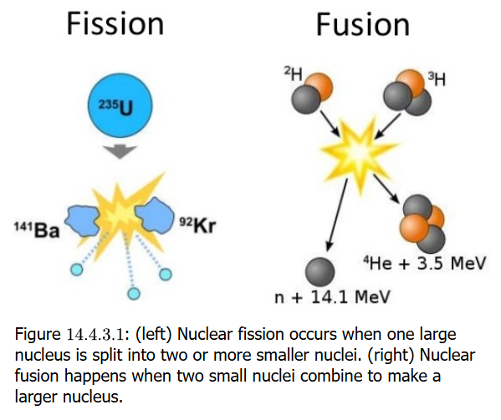

Atomic Fission & Fusion
Fission reactions are when nuclei break up into two or more smaller nuclei
In the fission reactor:
$${}_{92}^{235}{U+{}_{}^{1}n}→{}_{56}^{141}{Ba+}{}_{36}^{92}{Kr}+3{}_{}^{1}n+200 MeV$$
Fusion reactions are when nuclei are brought together to form larger nuclei
In the Sun: ${}_{1}^{1}H+{}_{1}^{1}H→{}_{1}^{2}{H+}{}_{1}^{0}{e^{+}}$ ${}_{1}^{2}H+{}_{1}^{1}H→{}_{2}^{3}{H+}γ$ ${}_{2}^{3}{He}+{}_{2}^{3}{He}→{}_{2}^{4}{He+}2 {}_{1}^{1}H$
In fusion reactor: ${}_{1}^{2}H+{}_{1}^{3}H→{}_{2}^{4}{He+}{}_{}^{1}n+17.6 MeV$

Slide 19
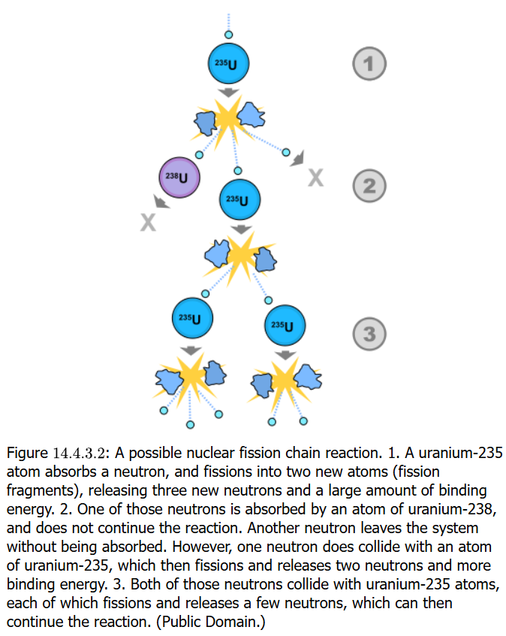
Fission Chain Reaction
Nuclear fission of U-235 is a self-sustaining chain reaction in which a neutron starts the process and yields three neutrons, any of which can strike another U-235 atom and continue with another fission
Nuclear-based energy and usually low energy level radioisotopes have many constructive and useful applications, not just in weapons

Slide 20
Fission Chain Reaction
Nuclear fission of U-235 is a self-sustaining chain reaction in which a neutron starts the process and yields three neutrons, any of which can strike another U-235 atom and continue with another fission
Nuclear-based energy and usually low energy level radioisotopes have many constructive and useful applications, not just in weapons

Slide 21
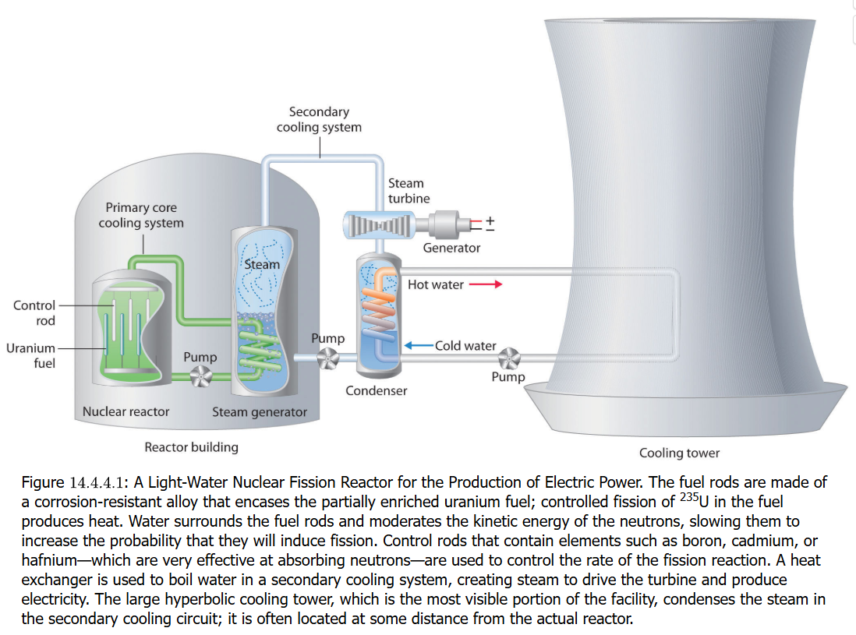
Nuclear-Generated Energy
Discovery of Radioactivity

Slide 22
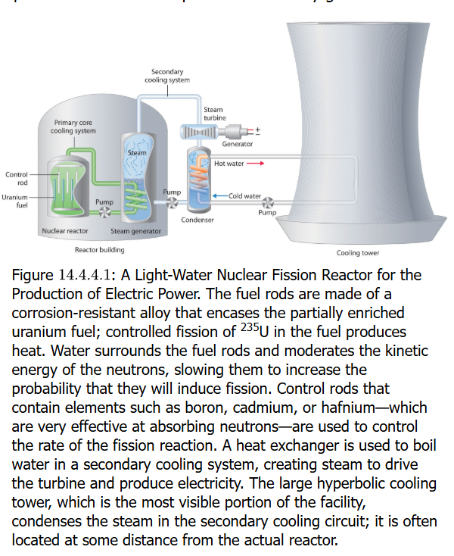
Atomic Fission
Discovery of Radioactivity

Slide 23
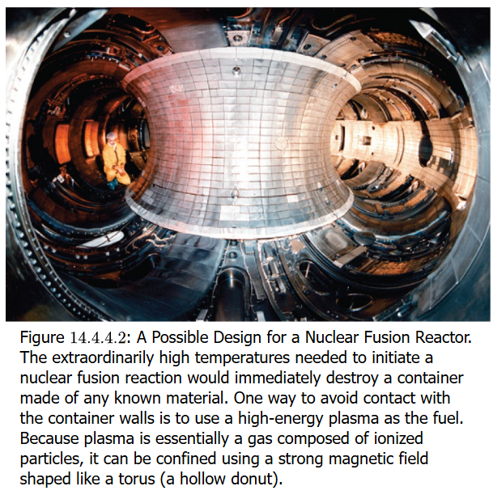
Atomic Fission
Discovery of Radioactivity

Slide 24
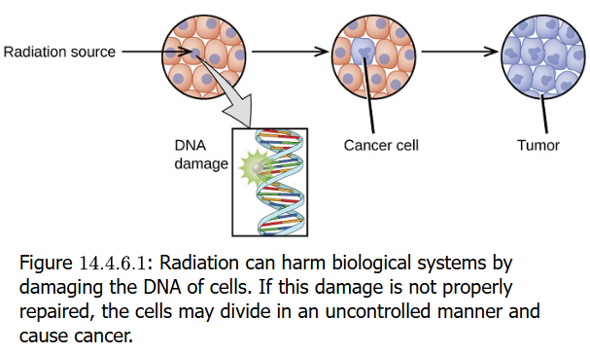
Atomic Fission
Discovery of Radioactivity

Slide 25
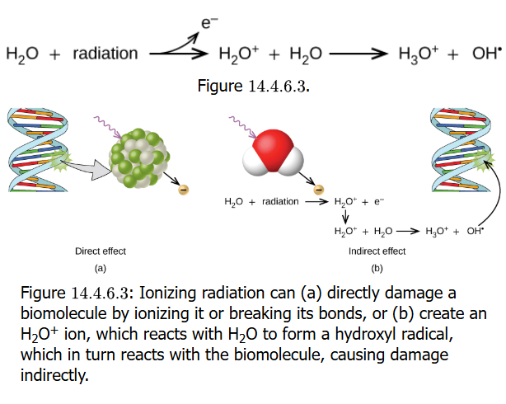
Atomic Fission
Discovery of Radioactivity

Slide 26
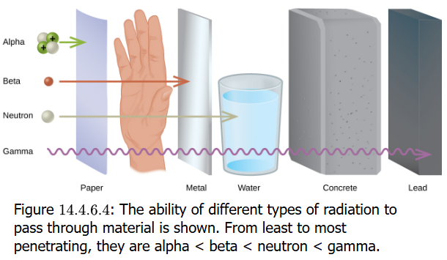
Atomic Fission
Discovery of Radioactivity

Slide 27
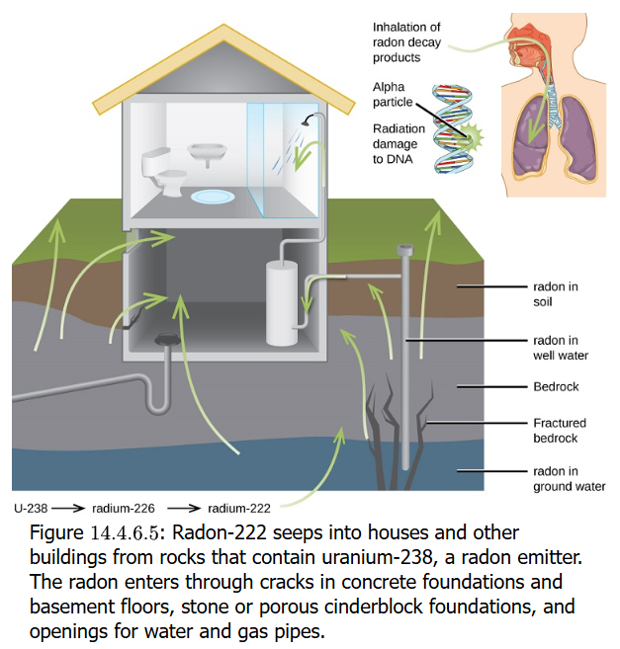
Atomic Fission
Discovery of Radioactivity

Slide 28
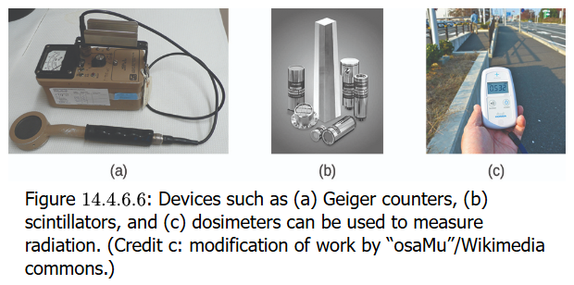
Atomic Fission
Discovery of Radioactivity

Slide 29
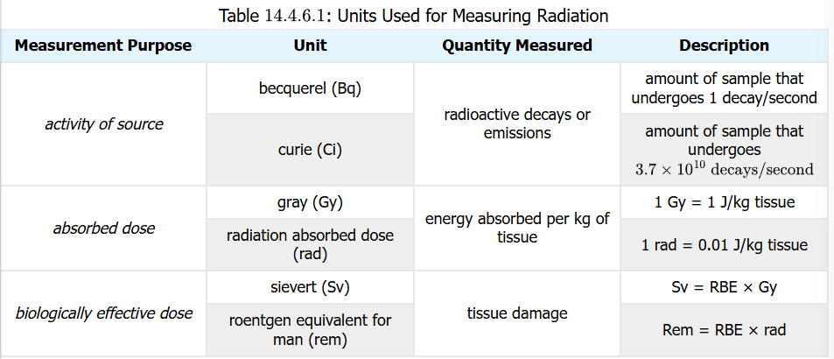
Atomic Fission
Discovery of Radioactivity

